Slide 1
Carbon capture and storage and the Canadian oil sands
Oil Sands Dialogue
Report
July 2022
Celina Hwang, Director, celina.hwang@ihsmarkit.com
Kevin Birn, Chief Analyst, Canadian Oil Markets, kevin.birn@ihsmarkit.com
Eleonor Kramarz, Executive Director, eleonor.kramarz@ihsmarkit.com

Slide 2
About this report
Since 2009, IHS Markit has provided research on issues surrounding the development of the Canadian oil sands. This report focuses on carbon capture and storage and the Alberta oil sands. The Canadian oil sands announced their Pathways to Net Zero initiative to accelerate their emission reduction ambition. Carbon capture and storage (CCS) is a critical opportunity that could make large scale emission reductions in the oil sands. This report will explore CCS and its potential in the Alberta oil sands. What are its components and what are the unique opportunities and challenges in relation to the oil sands.
Context. This report is part of a series of reports from the IHS Markit Canadian Oil Sands Dialogue. The dialogue convenes stakeholders to participate in an objective analysis of the benefits, costs, and impacts of various choices associated with the development of the Canadian oil sands. Stakeholders include representatives from government, regulators, oil companies, and nongovernmental organizations.
This report and past Canadian Oil Sands Dialogue reports can be downloaded at www.ihsmarkit.com/oilsandsdialogue
Methodology. IHS Markit conducted its own extensive research and analysis on this topic, both independently and in consultation with stakeholders. The work was completed in late 2021 prior to recent changes in federal policy, which could alter some of the key insights.

Slide 3
Oil sands emissions 4
Where do emissions come from?
What is the scale and how has that changed over time?
The global experience with carbon capture and storage (CCS) 19
What is CCS, how does it work, and what are the opportunities and challenges?
CCS is advancing around the world. What are these various projects, their objectives, and contexts?
Carbon capture and storage in the oil sands 32
What are the unique opportunities and challenges for CCS in the oil sands including geography, coordination of new projects, and capture issue based on streams?

Slide 4
Oil sands emissions
Where do emissions come from?
What is the scale and how has that changed over time?
Kevin Birn, Chief Analyst, Canadian Oil Markets, kevin.birn@ihsmarkit.com

Slide 5
Key messages
Pressure to accelerate the energy transition is building and domestically Canada is seeking a 40–45% reduction in greenhouse gas (GHG) emissions by 2030 from 2005 levels. However, few reductions have been achieved to date leaving only eight years for Canada to make very sizeable reductions in order to meet its ambition. This will require actions from across the economy, including oil and gas, which has historically been a source of GHG emissions growth.
Over the past decade oil sands growth made it a major economic engine, but that growth also outstripped GHG intensity reductions, leading to a rise of absolute emissions. Since 2009 (the earliest IHS Markit can accurately estimate oil sands emissions), oil sands production more than doubled, GHG intensity fell by 21%, and absolute emissions rose by 29 million metric tons (MMt).
Oil sands operations share many similarities with industrial plants, relying heavily upon stationary combustion sources that make them aimable for carbon capture and storage (CCS). IHS Markit estimates about 85% of oil sands emissions come from stationary combustions with varying degrees of CO₂ concentration, which impacts capture cost.
There are multitude of factors that influence the relative attractiveness and opportunities for CCS in the oil sands. This includes not only the purity of CO₂ found in flue gas streams, but also retrofitability, as well as transportation cost. Although emissions from hydrogen production may have the highest concentration of CO₂ in the oil sands, ease of access may be a challenge in comparison to free standing boilers for example.

Slide 6
Canada’s emission composition
11-Mar-22 7:01:04 PM
by yoges.palaniappan

Slide 7
Composition of oil and gas sector GHG emissions in 2019
11-Mar-22 8:27:05 PM
by yoges.palaniappan

Slide 8
Change in oil sands emissions (intensity, absolute, and production)
11-Mar-22 8:37:59 PM
by yoges.palaniappan
Production
>100% 1.5 million b/d
GHG intensity
20% or 17 kgCO₂e/bbl
Note: SCO = Synthetic crude oil. SAGD = Steam-assisted gravity drainage. CSS = Cyclic steam stimulation. PFT = Paraffinic froth treatment.

Slide 9
The value of Canada’s hydrocarbon sector has grown along side production growth with significant potential value forecast
11-Mar-22 7:06:08 PM
by yoges.palaniappan

Slide 10
The pace of global action to tackle climate change has been accelerating
Nations have announced a net-zero target for all GHGs, but others (notably, mainland China and India) are targeting only CO₂
Percent of global GHG emissions
91%
192 parties to the Paris Agreement
154 parties with net-zero goals
48
16
13%
Parties with long-term plans for net-zero goals
61%
Parties with net-zero goals in law
Note: As of 5 November 2021.
Source: IHS Markit
© 2022 IHS Markit

Slide 11
Low decline rate and operating costs below the incremental supply cost of most of the rest of the world may make oil sands resilient in lower-demand scenarios
Oil sands average cost of supply

Slide 12
Canada’s national ambition
11-Mar-22 9:24:59 PM
by yoges.palaniappan
Canada is targeting a 40–45% reduction in absolute GHG emissions by 2030 relative to 2005
Numerically Canada’s GHG emissions have remained relatively flat between 700 MMt to 730 MMt over the past 15 years
Within eight years Canada would require between 280 to 320 MMt eliminated.
Achieving Canada’s ambition will require significant reductions from across its economy, including oil and gas.
The Oil Sands Pathways to net zero have set a collective ambition of 22 MMt reduction from 2018 by 2030, which represents a significant change from the past.

Slide 13
The source of oil sands emissions vary by operation
Integrated mining (Mines with upgraders that market synthetic crude oil)
Unintegrated mining (PFT) (Mines without upgraders that market diluted bitumen)
Steam-assisted gravity drainage (SAGD) (Thermal in situ facilities that drill horizontally for bitumen and market diluted bitumen)
Cyclic-steam stimulation (CSS)
(Thermal in situ facilities that drill vertically for bitumen and market diluted bitumen)

Slide 14
Most emissions come from the use of hydrocarbons, most notably gas, but also diesel for the mine fleets, and petroleum coke …
14-Mar-22 9:20:25 PM
by yoges.palaniappan
Integrated mining (SCO)
Unintegrated mining (PFT)

Slide 15
… with most GHG emissions occurring from stationary combustion sources, particularly, heaters, boilers, and cogeneration
14-Mar-22 9:34:12 PM
by yoges.palaniappan

Slide 16
Different concentrations of CO₂ emission sources influence capture cost, with lower purity streams having high costs to dehydrate and compress
14-Mar-22 9:45:36 PM
by yoges.palaniappan

Slide 17
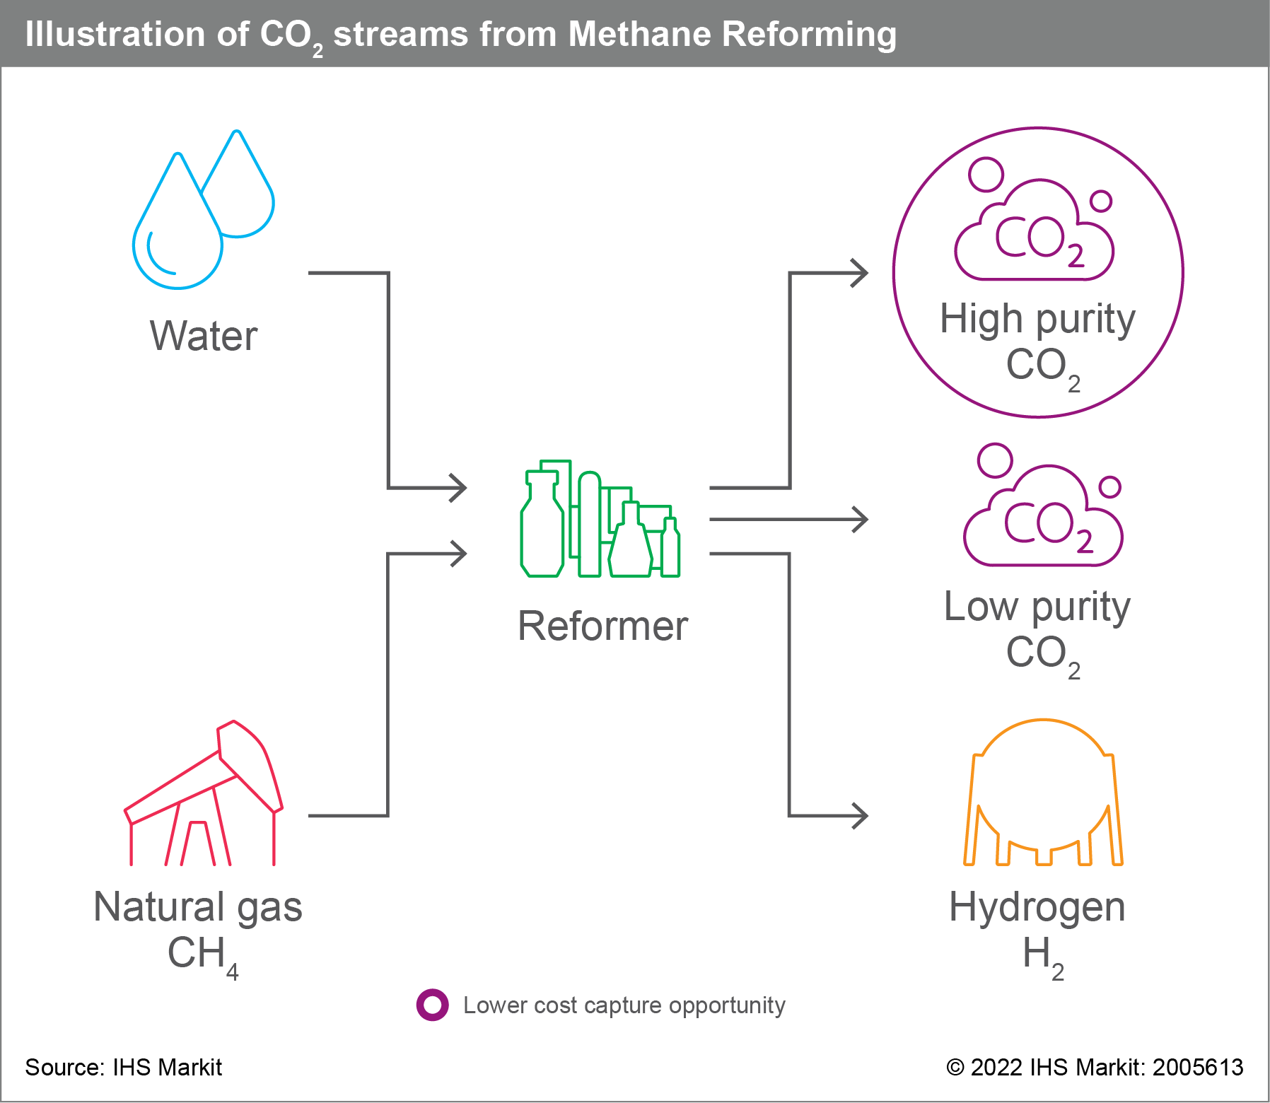
Capture opportunities from steam methane reforming would be among the lowest opportunities in the oil sands
14-Mar-22 9:54:13 PM
by yoges.palaniappan
Illustration of CO₂ streams from methane reforming

Slide 18
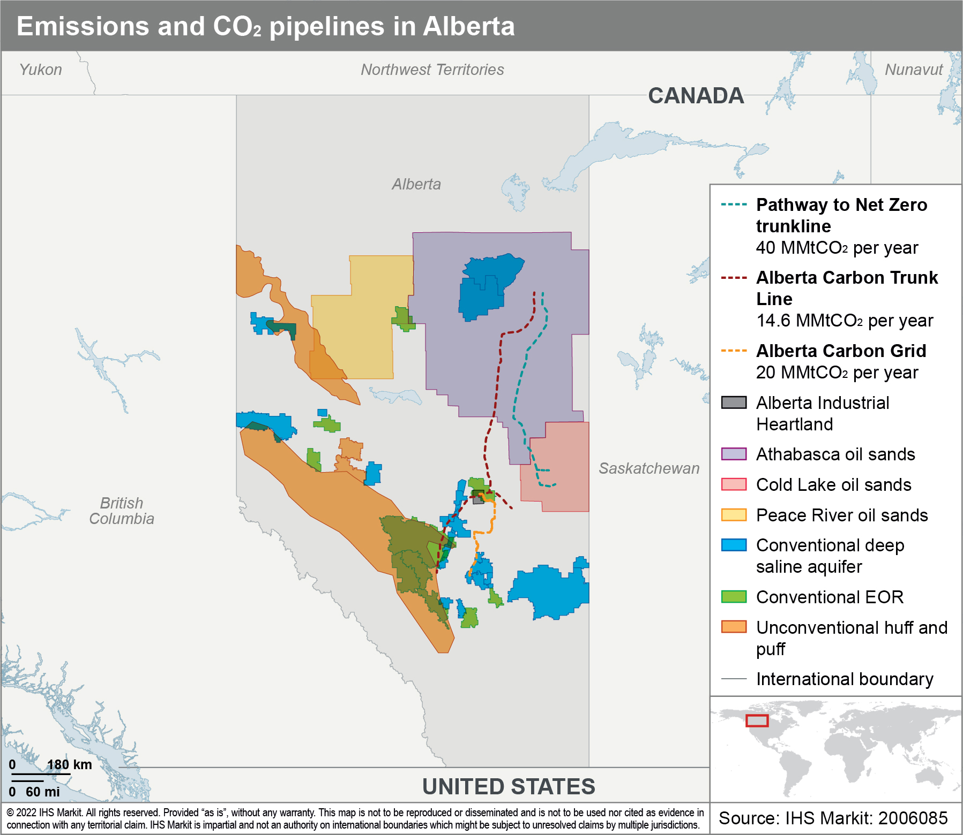
Key consideration is also the need to transport captured CO₂ to potential use or sequestration sites
Alberta already has an established carbon trunk line connecting industrial facilities near Red Deer and in Fort Saskatchewan with sequestration near Edmonton.
Most oil sands operations are far from sequestration opportunities and long-distance transportation infrastructure is already being proposed.

Slide 19
The global experience with carbon capture and storage (CCS)
What is CCS, how does it work, and what are the opportunities and challenges?
CCS is advancing around the world. What are these various projects, their objectives, and contexts?
Celina Hwang, Director, North American Crude Oil Markets, celina.hwang@ihsmarkit.com

Slide 20
Key messages
CCS hubs are becoming an important piece of the future of carbon capture development. Carbon capture clusters and shared transportation and storage could reduce costs through economies of scale and decrease leverage risk.
The United States and United Kingdom are anticipated account for approximately 70% of carbon capture capacity in the next five years. The United States is expected to account for 50% of the global capacity, nearly half of which is CCS capacity. The United Kingdom is looking toward primarily CCS capacity.
Many CCS projects currently announced to proceed has received governmental support to reach financial viability. The inability to monetize captured carbon through CCS projects suggests government support via subsidies, tax credits, carbon credits, and/or grants is needed to make the project financially viable.

Slide 21
During 2021, two large-scale new projects started operations, increasing total capture capacity to around 46 MMt/y
Total CO₂ cumulative capacity
46 MMt/y
© 2022 IHS Markit
Carbon capture and utilization (CCU) projects have been the main driver for capacity growth in the past 10 years. These projects have mainly been using CO₂ for enhanced oil recovery (EOR) activities led by oil and gas companies. IHS Markit expects to see a shift toward CCS projects in the next five years.
CCS projects only account for 16% of the current capacity; however, this solution has a significant potential to grow as characterization of storage sites improves in different regions.

Slide 22
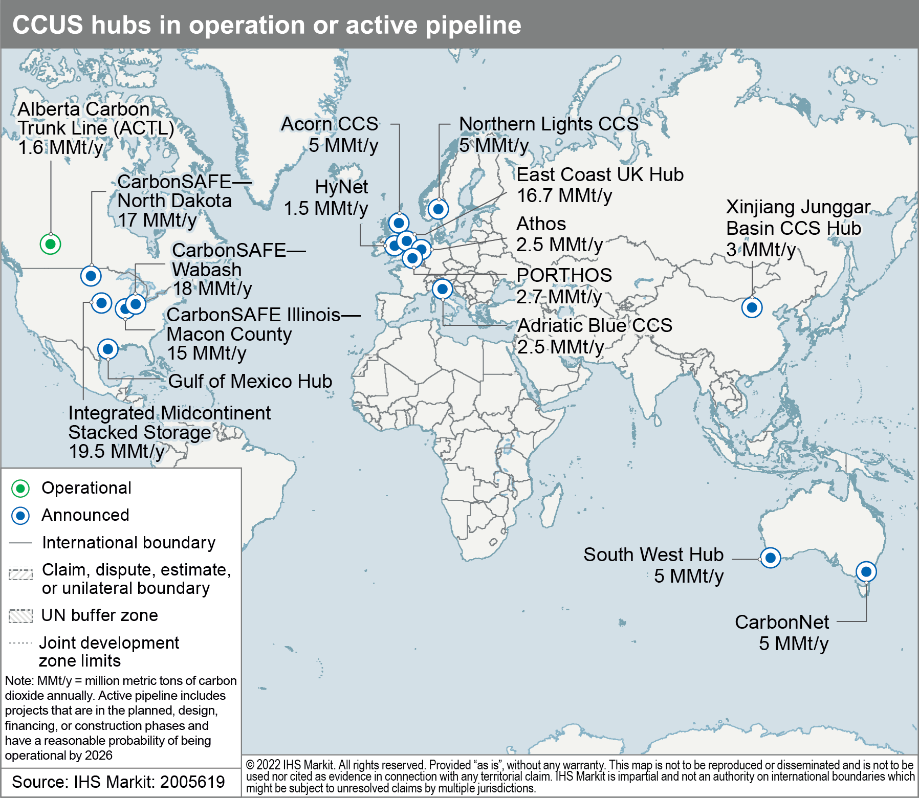
Capture, transport, and storage hubs are becoming important drivers for future carbon-capture development
One approach gaining traction is to identify or establish industrial “clusters” where an at-scale carbon-capture infrastructure buildout can be leveraged to capture emissions and transport them to an offsite storage area or “hub.” While clusters are associated to multiple emitting facilities located in the same geographic location, hubs are associated to shared transportation infrastructure and storage. Hubs are a game changer because they decrease the investment risk and could reduce costs through economies of scale. Examples of hubs:
East Cost UK hub in the United Kingdom
Porthos in the Netherlands
Alberta Carbon Trunk Line (ACTL) in Canada
CarbonNet in Australia
Xinjiang Junggar Basin CCS hub in mainland China
Norway’s Northern Lights—Longship and the Netherlands’ Port of Rotterdam CO₂ Transport Hub and Offshore Storage (Porthos) are in an advanced stage of development.
Storage hubs are also garnering interest in the United States as evidenced by continuing work funded by the US DOE and the recent announcement of the Gulf of Mexico hub
ACTL is the first hub currently operating, with two capture facilities closely located and a shared transportation and storage infrastructure this project is the first of its kind in the region.
Updated. Sent original file

Slide 23
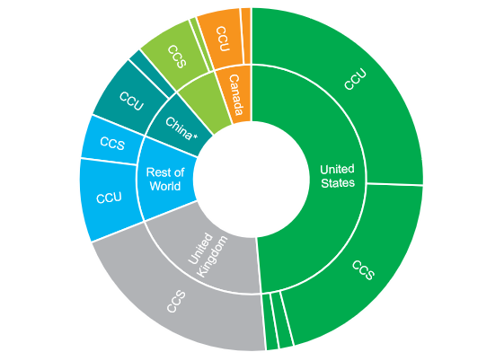
United States and United Kingdom are expected to account for around 70% of the capture capacity in the next five years
The United States will continue to be the leader of the market accounting for 50% of the capture capacity expected in the next five years from the active pipeline* of projects.
United Kingdom is a new player in the market. The country’s decarbonization strategy identified CCS as a key technology to meet its net-zero target.
Mainland China’s project pipeline is driven by CCU projects using the CO₂ captured for EOR.
Capture capacity for the rest of Europe is expected to more than double in the next five years mainly driven by the projects in Norway.
Government support from European countries has been critical for the development of a solid pipeline of CCS projects for the next five years; however, the high costs of these projects could limit the growth in the long term.
6%
6%
28%
7%
Rest of Europe
28%
7%
5%
5%
8%
8%
68 MMt/y
22%
22%
22%
22%
Note: *Active pipeline includes projects that are in the planned, design, financing, or construction phases and have a reasonable probability of being operational by 2026.

Slide 24
An influx of announced CCUS projects was seen in 2021, larger in scale than projects completed in the prior decade
Canadian CCUS projects prior to 2020 were relatively small scale; however, they have been important in the development of CCUS globally.
The Alberta Carbon Trunk Line came into service in 2020, which was the first hub project completed globally.
A number of CCUS projects were announced in 2021 with anticipated start-up dates of 2024–26.
In March 2022, the government of Alberta selected six projects to work with the government to evaluate the location suitability of storing carbon
TC Energy and Pembina announced the Alberta Carbon Grid, which aims to transport up to 20 MMtCO₂/year.
Shell’s Polaris CCS aims to capture 750,000 metric tons of CO₂/year from the Scotford refinery and chemicals plant.
CCS projects
CCU projects
Other projects
Alberta Carbon Grid—transport and storage
Alberta Carbon Trunk Line
Shell Polaris
Cumulative maximum CO₂ captured or injected/stored (MMt/year)
Cumulative maximum CO₂ captured or stored
Shell Quest

Slide 25
Shell Quest CCS experience
Quest is located at the Scotford upgrader and is part of the Athabasca Oil Sands Project.
CO₂ is captured at the Scotford upgrader, then transported 65 km via pipeline to three injections wells to be permanently stores 2 km underground.
Captures and stores approximately 1 MMtCO₂/year.
Estimated to be one-third of the CO₂ emissions from the Scotford upgrader.
Planning and preliminary design began in 2009 with completion of the project in in September 2016.
Awarded C$120 million from Canadian Energy Fund and C$745 million from the Province of Alberta.
Total cost of approximately C$1.35 billion.

Slide 26
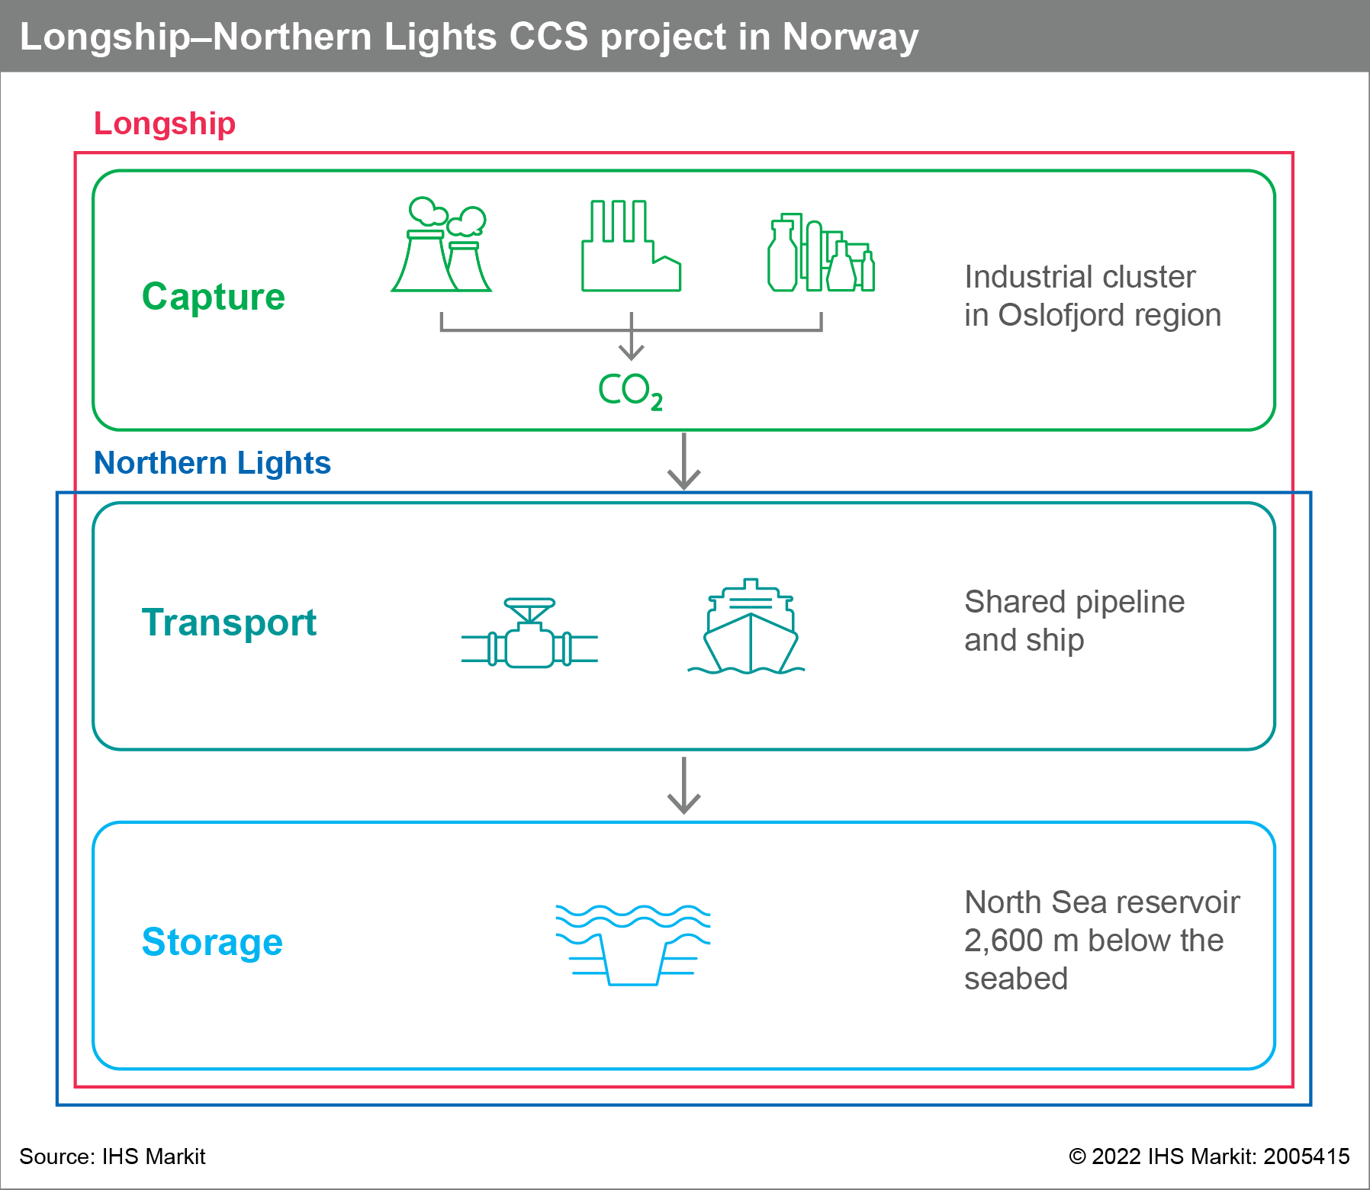
Longship—Northern Lights located in Norway with estimated storage of 1.5 MMtCO₂/year
The project is a collaboration between state and private firms. Gassnova coordinated the overall project schedule and managed cross-chain risks and functionality, while Equinor, Shell, and TotalEnergies partnership is responsible for Northern Lights transport and storage design, construction, and operation, and Norcem and Fortum Oslo Varme will be capturing the carbon.
State aid provided the individual companies secured sufficient and funding from the European Union and their own funding to meet total cost.
State aid is for construction and first 10 years of operation
State funding is estimated to be 40–85% of total capital cost for each portion of the project. Northern Lights, Norcem, and Fortum Oslo Varma estimated to receive state aid covering over 70%, 80%, and 40% of the costs, respectively.
Estimated cost for the CCS chain is C$185/metric ton*
Nearly half is for storage and transport (capture is 700 km away from storage and needs to go on a ship).
Norway Climate Change Act aims for 50% reduction by 2030 compared to 1990 levels.
2018—Climate Change Act (legally binding)
Oct 2019—Norway, Iceland, and the European Union formally agreed to cooperate on fulfilling respective emissions targets by 2030
Part of the EU ETS (emissions trading system)
Note: *Gassnova report “Developing Longship—key lessons learned”

Slide 27
Helped along by government funding and coordination, the project will take nearly a decade to reach an in-service date
Timeline of key events in the Longship—Northern Lights CCS project
Late 2018 to late 2019
FEED study for capture completed by Gassnova and Equinor
December 2020
Norwegian government takes investment decision and names the project “Longship”
Mid-2015 to mid-2016
Feasibility studies on capture, transportation, and storage completed by the Norwegian government
Mid-2017
Concept study for capture completed by Gassnova and Equinor
March 2020
Exploration well drilled that confirmed the storage reservoir viability
2024
Expected online date
2017
Equinor, Shell, and TotalEnergies form Northern Lights partnership
Mid-2017 to early 2019
Concept studies for transportation and storage completed by Gassnova and Equinor
May 2020
Equinor, Shell, and TotalEnergies take investment decisions
March 2021
Northern Lights incorporated as a partnership between Equinor, Shell, and TotalEnergies
Early 2019 to mid-2020
FEED study for transportation and storage completed by Gassnova and Equinor
Source: IHS Markit
© 2022 IHS Markit

Slide 28
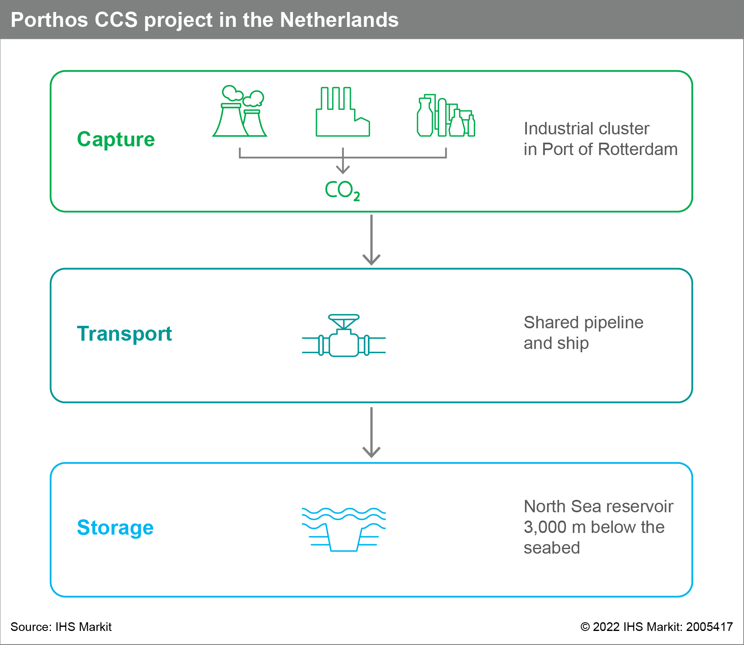
Porthos—Port of Rotterdam, Netherlands CO₂ Transport Hub and Offshore Storage with estimated storage of 2.5 MMtCO₂/year
Private, public, and non-profit companies come together in this integrated project. Porthos is a joint venture between EBN (European Business and Innovation Center Network), Gasunie (energy network operator), and Port of Rotterdam Authority. Air Products refinery, Air Liquide refinery, ExxonMobil refinery, and Shell refinery and chemical plant will be the capture sources.
Funding awarded in May 2021 from the SDE++ fund*. Combined, the companies have requested nearly US$2.4 billion in subsidies.
Netherlands Climate Act aims for a 49% reduction in emissions by 2030 compared to 1990 levels.
2019—Netherlands Climate Act (legally binding). Plan to stimulate industry to reduce emissions with a CO2 tax and the SDE++ subsidy.
2019—Norway, Iceland, and the EU formally agreed to cooperate on fulfilling respective emissions targets by 2030.
Part of the EU ETS (emissions trading system).
Note: *SDE++ = Sustainable Energy Transition Scheme

Slide 29
Porthos nearing the finish line for investment decision
Timeline of key events in the Porthos CCS project
August 2019
Non-binding Joint Development Agreement 1 signed
2022
Expected final investment decision
July 2019
Awarded €6.5 million in CEF subsidy by European Commission for preparation studies
February 2021
Awarded €102 million in CEF subsidy by European Commission for construction
May 2021
Awarded US$2.4 billion in subsidies through the Dutch government SDE++ fund
April 2018
Completion of feasibility study
2024
Expected online date
Early 2019
Start of FEED phase and technical development
Autumn 2020
Joint Development Agreement 2 signed by ExxonMobil, Shell, Air Liquide, and Air Products. Working towards operation start up in 2024
Autumn 2021
Signing of transport and storage contracts
Note: CEF = Connecting Europe Facility
Source: IHS Markit
© 2022 IHS Markit

Slide 30
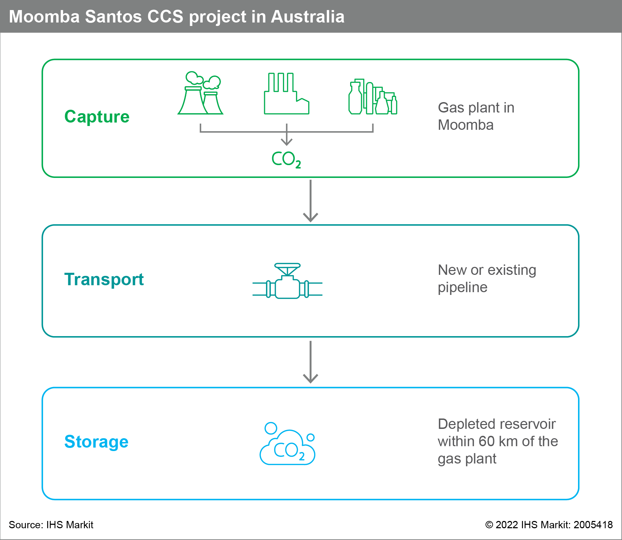
Moomba Santos—Australia CO₂ capture and storage with estimated storage of 1.7 MMtCO₂/year
Santos is the primary creator for the entire project, backed by joint venture partners. Santos and Beach Energy have a joint interest in Moomba—66.7% and 33.3%, respectively. BP entered into a non-binding agreement with Santos that could lead to BP investing AU$20 million in the project.
Santos estimates the project to cost US$165 million. Project will receive tradeable carbon credits through the Emissions Reduction Fund.
Credits can be sold to the government or on the secondary market.
Will qualify for credits for 25 years.
Santos’s 2020 estimate for CCS cost was AU$30/metric ton of CO₂.*
Long-Term Emissions Reduction Plan to achieve net zero by 2050 adopted in 2021.
Technology-led approach intended to drive down costs of emission reduction and low emission technology for large scale deployment.
Government’s role is to invest in infrastructure; ensure transparency and knowledge sharing; and provide incentives to deploy emerging technology
No mandated targets and no carbon taxes.
Emissions Reduction Fund introduced in 2015.
Provides incentives for organizations and individuals to adopt new practices and technology to reduce emissions and store carbon
Participants can earn carbon credits which can be sold to the government or in the secondary market
Source: *https://www.petroleum.sa.gov.au/media/shared/pdf/petroleum/roundtable/roundtable_meetings/roundtable-meeting-2020/Winterfield-Christian-Moomba-CCS-Project-2020-Roundtable-for-Oil-and-Gas-Final.pdf

Slide 31
Moomba CCS recently given final investment decision after receiving government funding and ability to generate carbon credits
Timeline of key events in the Moomba CCS project
June 2021
Awarded $15 million grant from Australian Government
2018
Engineering studies, modelling, and potential storage site work started
November 2021
Santos gives final investment decision of US$165 million for Moomba
2024
Expected online date
2006
Project initiation
2008
Project put on hold
March 2020
Santos and BP enter a non-binding agreement
October 2021
CCS becomes part of the ERF. Moobma registered as a project
Note: ERF = Emissions Reduction Fund
Source: IHS Markit
© 2022 IHS Markit

Slide 32
Carbon capture and storage in the oil sands
What are the unique opportunities and challenges for CCS in the oil sands including geography, coordination of new projects, and capture issue based on streams?
Eleonor Kramarz, Executive Director, eleonor.kramarz@ihsmarkit.com

Slide 33
Key messages
Alberta is a hard place to decarbonize while preserving economic benefits, and while low-cost opportunities exist, their impact will be limited.
Alberta’s heavy industries competes with numerous countries with less stringent environmental and climate policy regimes.
Decarbonization of Alberta heavy industries can protect the economics benefits (nearly C$100 billion in GDP), and attract new development by enabling decarbonization while remaining competitive globally.
Greenfield projects can achieve reductions at a much lower cost.
A CCS and hydrogen hub approach will be a key enabler to a lower emission economy.
Given the capital-intensive and cross-sector nature of CCS, the proper policies are key to reduce investment risk and, in turn, cost of capital.
A long-term collaborative framework is key to advance CCS and support the viability of the industrial sector (including oil and gas).

Slide 34
Alberta’s large share of industrial emissions complicates decarbonization
Percentage of industrial emissions
276
Industrial emissions
Percent of GHG emissions
163
38%
75
21%
66
11%
152
11%
732
17%
25%
Source: IHS Markit
© 2022 IHS Markit

Slide 35
Demand for heat in oil sands, refining, and other heavy industries leaves fewer options outside of CCS and H₂ for large scale decarbonization
GHG intervention options to address brownfield infrastructure
Industrial GHG emissions in Alberta¹
Selected GHG intervention options
Commentary
MMtCO₂/year
Digital and physical energy efficiency, steam displacement (e.g., solvent), power switching, cogen conversion, CCS, improved tailing technology, H2 and RNG¹
Existing trends from IHS Markit research shows avoided emission of ~10MT from baseline by 2030⁴; deep decarbonization is difficult without CCS due to significant heat requirement across oil sands operations
Oil sands
81
General efficiency improvements , NGL extraction, flaring reduction, methane (fugitive, venting) reduction, fuel switching, renewables
Alberta has committed to a 45% methane reduction target by 2025⁵, representing ~5% of midstream’s carbon footprint; electrification and fuel switching can help address significant portion of CO₂ emissions
Other E&P and Midstream²
52
Fuel switching (natural gas or renewables + storage), end use energy efficiency, generation efficiency improvements, waste-to-gas, CCS
~31% of power sector generation (est. 23.8 TWh in 2020) from to coal will retire or convert to natural gas by 2023⁶, with further decarbonization driven by additions of renewable power
Power generation
33
Refining³ and heavy industries
General plant energy efficiency gains, feedstock and fuel switching, renewables, CCS, SMR⁸ with CCS, use of green hydrogen
Canada’s CFS⁷ will indirectly affect co-processing related heavy industry segments by driving demand for co-processing (soy, canola); CCS will play a key role in decarbonization due to high heat requirements within the industry
25
Note: 1. Renewable natural gas, 2. Includes natural gas production and processing, 3. Includes oil processing, 4. IHS Markit (2018) “Greenhouse gas intensity of oil sands production: Today and in the Future.” 5. Reducing methane emissions | Alberta.ca, 6. Alberta set to retire coal power by 2023, ahead of 2030 provincial deadline - JWN Energy, 7. Clean Fuel Standard - Canada.ca, 8. Steam methane reforming
Source: Canada National Inventory data (year 2018)
© 2022 IHS Markit

Slide 36
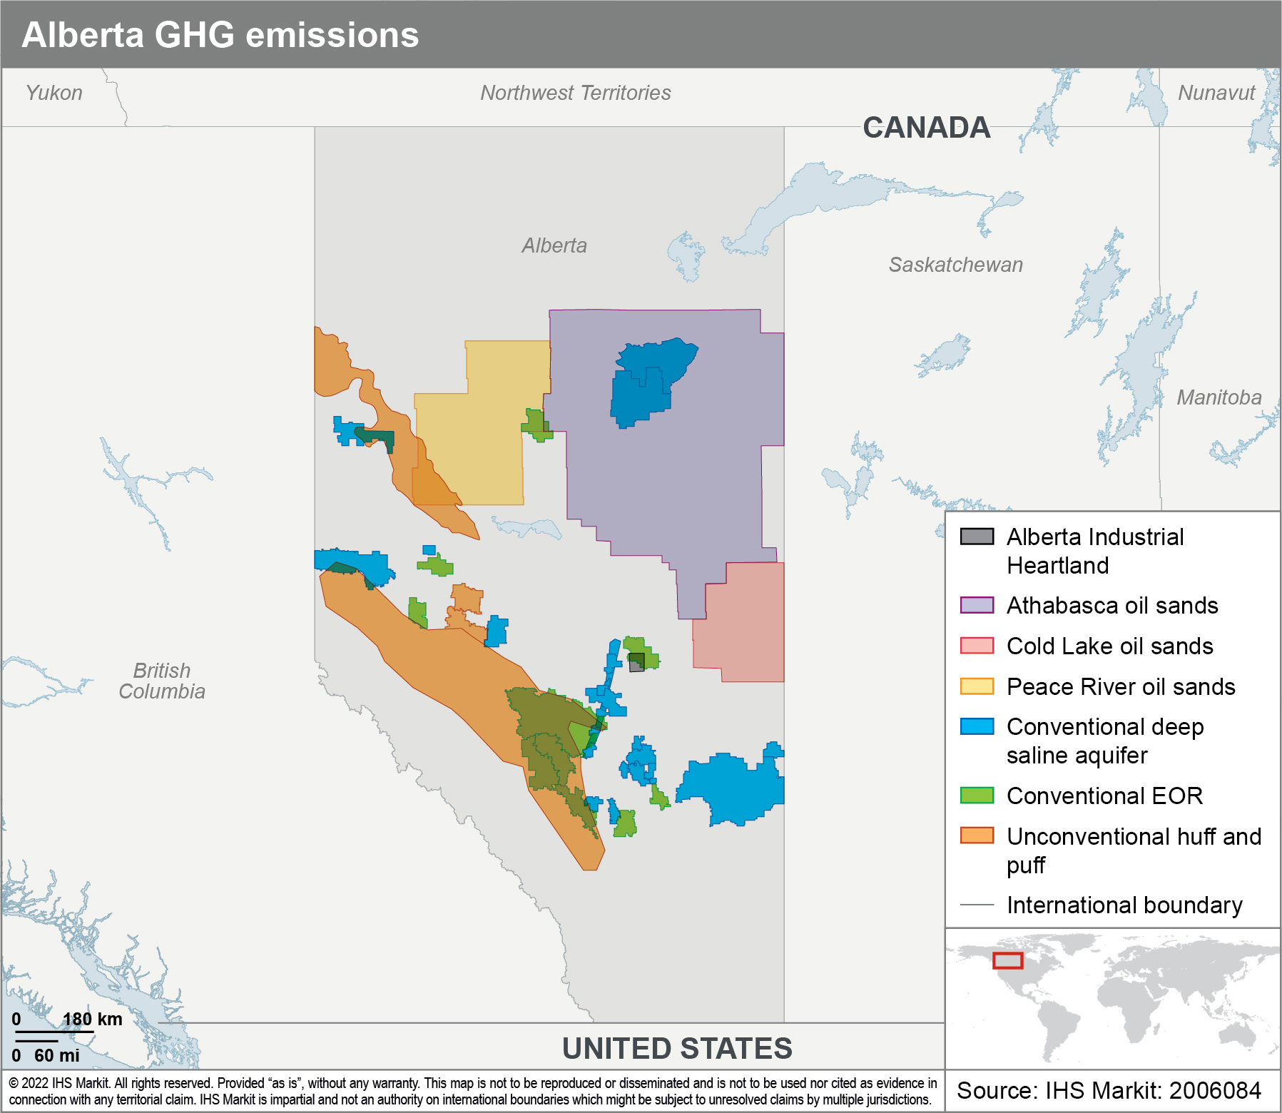
There are significant cost efficiencies from a hub-based approach to development of new CO₂ pipelines, but this requires coordination
1
2
3

Slide 37
CCS projects can take nearly 10 years to bring online from conception to completion; Canada must act now if its decarbonization goals are to be met
High-level development timeline—CCS project example
Provincial planning
Hub vetting, selection of policy and financial levers
Engineering design and permitting
2–3 years for design and permitting of CO₂ capture, transportation and sequestration facilities
Construction
3–5-year construction timeline for capture projects, assuming transportation and sequestration facility construction is aligned
Project vetting
Initial funding decision, project vetting and due-diligence, stakeholder engagement
Larger, more complicated projects
Year 0
Year 5
Year 8
Year 10
Source: Clean Air Task Force; CCS Knowledge Centre
© 2022 IHS Markit

Slide 38
Other nations have begun to overtake Canada’s early leadership in CCS
The Canadian government, as well as provincial governments in Alberta and Saskatchewan, have provided grant funding for major operating CCS/CCUS projects
The United States has been leading in terms of CCS projects, in large part thanks to an established tax credit for CCS (45Q)
Norway, the United Kingdom, and the Netherlands have provided state support to CCS projects.
Norway is a regional leader in terms of CCS deployment, with a US$1.8 billion investment in Northern Lights CCS Project
In the United Kingdom, the government has made available US$190 million for CCS research programs and pilot projects
However, development lags due to frequent policy shifts, contract cancellations, and potential UK exit of ETS (post-Brexit)
Netherlands follows next with Porthos and Athos full-scale CCS projects and SOEs3 have played a major role
CCS will be needed to support mainland China’s recent commitment to a carbon-neutral future by 2060 and it’s actively developing CCS capacity with seven of eight CCS projects being in construction or planning phase.

Slide 39
Scaled CCS projects deployment will incentivize breakthroughs that will lower future costs and encourage technology breakthroughs
CCS/CCUS technology development activity and cost reduction opportunities
CO₂ capture
CO₂ transport
CO₂ sequestration and utilization
Key technologies and reduction drivers
Absorption
Adsorption
Membrane
Cryogenic
Hub development
Storing CO₂ in products
Use of CO₂ as feedstock
Reduce regeneration energy load
Increase of capture capacity
Increase of separation efficiency
Reduction of cooling load
Leveraging economies of scale via common infrastructure, government guarantees, and minimizing the time between infrastructure construction and full utilization.
Improvement of chemical processes
Reduction of processes’ energy intensity
Example activities
New solvent chemistries
New regeneration methods
New sorbent materials
More efficient reactor designs
New membrane materials
Optimize membrane unit configurations
Synergies with other processes or technologies (e.g., renewables)
Process intensification
Replacing carbon-intensive products with low carbon alternatives
Use of CO₂ as the feedstock for production of hydrocarbons and petrochemicals
Source: IHS Markit
© 2022 IHS Markit

Slide 40



Unaddressed economic and non-economic barriers can stall deployment of CCS and H₂ projects
Framework for barriers for emission reduction
Economic
Non-economic
Financial and commercial: Barriers to financing or commercializing an emission reduction pathway. For example: capex constraints, contractual terms, low commodity prices, lack of financing partners, risk perception
Institutional capacity: The ability of government to develop and implement policy and regulation (i.e., ability to enforce regulation, ability to uphold contracts, ability to prevent corruption)
Fiscal regime and regulatory: A government-imposed policy barrier to achieving emission reductions. Barriers could include the following: O&G fiscal terms, environmental policy, domestic power tariffs, etc.
Competing corporate incentives: Misalignment within companies (e.g., corporate management and business unit decision-making) or between companies (e.g., transport and storage guarantees; competitive behavior prohibiting sharing that would be beneficial to NPV and emissions reduction)
Technology: A technological barrier to emission reduction (i.e., technology availability, technology maturity)
Source: IHS Markit
© 2022 IHS Markit

Slide 41
Special thanks
Special thanks to the following teams at IHS Markit for their contribution to this report:
Clean Energy Technology
Upstream Consulting

